Slide 1
Health Protection Surveillance Centre
Annual trends update: HIV, Hepatitis and STIs among MSM in Ireland (to the end of 2018)
December, 2019

Slide 2
Acknowledgements
We would like to sincerely thank all who provided data for this slide set;
The National Virus Reference Laboratory (NVRL)
Microbiology Laboratories
Departments of Public Health
Consultants in Infectious Disease/Genitourinary Medicine
Staff working in HIV and STI clinics
GPs and all other clinicians involved

Slide 3
Technical Notes
Data were extracted from CIDR in Quarter 3 2019 and were correct at the time of publication
Data in CIDR are updated on an ongoing basis, updated data will be presented in subsequent reports
Increased notifications of HIV and STIs may be attributed, in part, to increased HIV/STI testing, however testing rates by risk group are not currently available
For calculation of the rate of notifications among MSM, the MSM population was calculated as 6% of the Irish male population aged between 18 and 64 years (Census 2016), as estimated by the Healthy Ireland survey (2015), which is a nationally representative survey

Slide 4
HIV

Slide 5
Overall trend in HIV

Slide 6
Trend in HIV by probable route of transmission

Slide 7
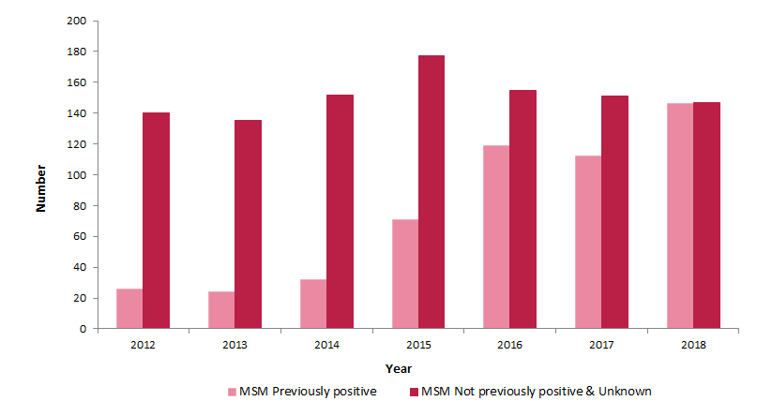
Trend in HIV among MSM by history of previous diagnosis abroad

Slide 8
Trend in HIV among MSM by age group

Slide 9
Trend in HIV among MSM by region of birth

Slide 10
Trend in HIV among MSM by region of birth (for those born outside Ireland)

Slide 11
HIV among MSM: Summary
Men who have sex with men are the group most affected by HIV in Ireland and account for more than half of diagnoses in recent years (56% in 2018)
Increasing number of HIV notifications among men who have sex with men in recent years (from 60 in 2003 to 293 in 2018)
An increasing proportion of men who have sex with men diagnosed with HIV in Ireland have a previous HIV diagnosis abroad (50% in 2018). The majority of these men have an undetectable viral load at time of their diagnosis in Ireland
The majority of men who have sex with men diagnosed with HIV in Ireland are born abroad (72% in 2018)

Slide 12
Early Infectious Syphilis

Slide 13
Early infectious syphilis (EIS): overall trends
Notifications of EIS have been increasing each year since 2013; national crude notification rate (CNR) increased from 4.0 per 100,000 population in 2013 to 10.2 per 100,000 in 2018
Notifications in 2018 increased by 22% compared to 2017 (485 vs. 398)
Some of the increase since 2013 may be due to increased sensitivity of the reporting system following updates to the case definition as well as updated laboratory criteria and procedure for notifying EIS (January 2014 and July 2016)
The majority of cases each year (>94%) are among men

Slide 14
Early infectious syphilis (EIS) among MSM, 2018
Notifications among MSM has increased each year since 2013
In 2018 notification rate among MSM increased by 13% to 356.6/100,000 MSM from 287.6/100,000 MSM in 2017
MSM remain the group most affected accounting for 86% of EIS notifications, where mode of transmission is known
Most MSM (62%) acquired EIS in Ireland
Large proportion of MSM diagnosed with EIS are HIV positive (40% where known)
Majority of notifications (79%) among MSM are reported by HSE East
Median age: 34 years (range: 19-76 years)

Slide 15
Rate of EIS notifications in MSM per 100,000 MSM population aged 18-64 years in Ireland, 2013-2018

Slide 16
Gonorrhoea

Slide 17
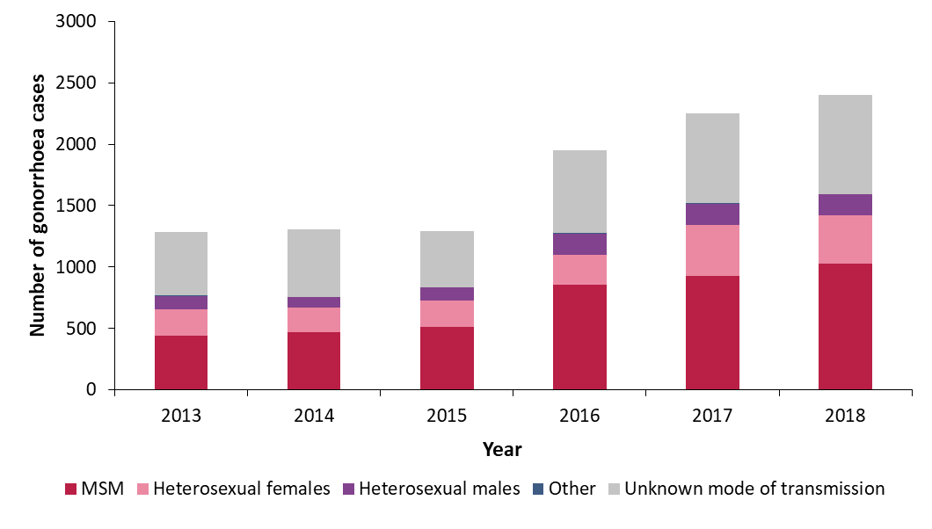
Overall trends in Gonorrhoea in Ireland, 2013-2018
Overall gonorrhoea notifications have increased by 86% since 2015 and MSM are disproportionately affected by gonorrhoea in Ireland
Where mode of transmission was known, 65% of cases were among MSM in 2018

Slide 18
Gonorrhoea among MSM in Ireland, 2015-2018
In 2018 the rate of gonorrhoea notifications among MSM* was 1,177/100,000 MSM (or 1.2% of MSM), which was double the rate reported in 2015
*aged 18-64 years

Slide 19
Gonorrhoea among MSM in Ireland, by age group
25-29 year olds were the age group most affected among MSM
The rate among 25-39 year olds increased, while the rate among 20-24 year olds decreased in 2018

Slide 20
Gonorrhoea among MSM in Ireland, summary
Overall notification rate of gonorrhoea in Ireland continued to increase in 2018
MSM were disproportionately affected by gonorrhoea, accounting for 65% of cases where mode of transmission was known, in 2018
The rate of notification among MSM has doubled since 2015 and was greater than 1 per 100 MSM in 2018 (or 1.2%)
The rate among older MSM (25-39) increased in 2018 while the rate among younger MSM (20-24) decreased in 2018

Slide 21
Lymphogranuloma venereum (LGV)

Slide 22
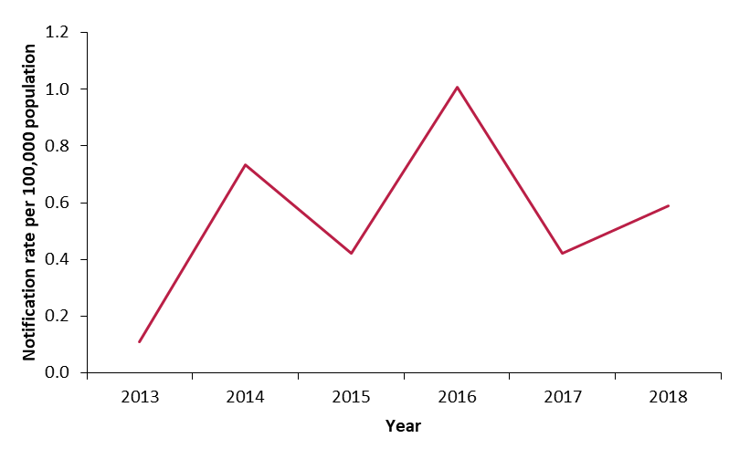
LGV among MSM
There were 28 notifications of lymphogranuloma venereum (LGV) in 2018 (0.6/100,000 population), up from 20 notifications in 2017

Slide 23
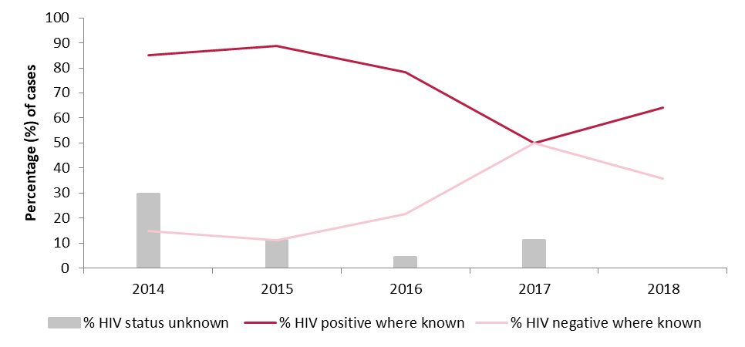
LGV among MSM
All LGV cases in 2018 were men who have sex with men
Median age: 36 years (range 22-58 years)
50% born in Ireland, 36% Latin America, 14% other European country
64% HIV positive, 36% HIV negative

Slide 24
LGV summary, 2018
The number of LGV notifications increased in 2018
All cases were men who have sex with men
Half of cases were born in Ireland, half were born abroad
64% were HIV positive

Slide 25
Hepatitis A

Slide 26
Hepatitis A among MSM
Hepatitis A virus shed in faeces - faecal-oral transmission
Safe & effective vaccine, free in STI clinics
Hepatitis A not identified in MSM in Ireland prior to December 2016
Very large European-wide outbreak 2016-2018
About 4,500 cases in Europe
Involved 3 strains of genotype IA hepatitis A: VRD_521_2016, RIVM-HAV16-090, V16-25801
Mostly male cases, and where known, mostly MSM
20 cases identified in MSM in Ireland, Dec 2016 to end 2017
Where sequence available, Irish cases mostly infected with VRD_521_2016 strain
5 hepatitis A cases identified as MSM in Ireland in 2018
4 part of an outbreak – genotype IB RIVM-HAV-17-090 strain
1 not sequenced

Slide 27
Hepatitis A cases in Ireland identified as MSM, Dec 2016 - 2018

Slide 28
Hepatitis C

Slide 29
Hepatitis C among MSM
Reports of increased numbers of MSM being diagnosed with hepatitis C from late 2015
Highest number reported in 2016
11 cases of hepatitis C identified as MSM in 2015, 32 in 2016, 15 in 2017 & 14 in 2018
MSM cases 2015-2018: age range 20-61 years, median 35 years
Country of birth reported for 76%: Most common regions of birth were Ireland (33%), Latin America (27%) and Central/Eastern Europe (20%)
56% HIV positive at time of diagnosis
55% of HIV positive cases and 34% of HIV negative cases diagnosed with syphilis, gonorrhoea, chlamydia, LGV or herpes in same year or year prior to hepatitis C diagnosis

Slide 30
Hepatitis C cases in Ireland identified as MSM, by HIV/other recent STI status, 2013-2018
*Gonorrhoea, syphilis, chlamydia, LGV or genital herpes simplex in the same year as or in the year prior to hepatitis C notification;
HIV status is as of year of hepatitis C diagnosis

Slide 31
Sexually Transmitted Enteric Infections (STEIs)

Slide 32
Sexually Transmitted Enteric Infections (STEIs) among MSM
Gut infections which cause stomach cramps, diarrhoea and sometimes vomiting
Transmission via faecal-oral route
Sexually transmitted shigellosis has been increasing among MSM in Europe, including Ireland
Often associated with antimicrobial resistance
Information for MSM on how to avoid shigellosis is available at: http://man2man.ie/wp-content/uploads/2017/02/Shigella-Leaflet.pdf

Slide 33
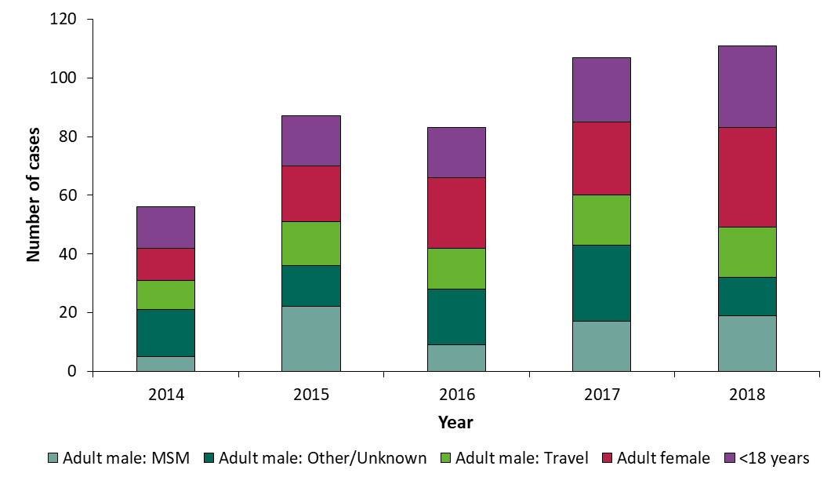
Overall trends in shigellosis in Ireland, 2014-2018
Shigellosis is typically associated with foreign travel, consumption of contaminated food or water and sexual transmission among MSM
MSM are disproportionately affected among adult males cases in Ireland

Slide 34
Summary: HIV and STIs among MSM
MSM are the group most affected by HIV in Ireland (56% of notifications in 2018) and 50% of MSM diagnosed with HIV in 2018 were previously diagnosed abroad.
MSM remain the group most affected by EIS (86% of notifications) and rates continue to rise (notification rate 356.6/100,000 MSM in 2018)
The rate of gonorrhoea notifications among MSM continued to increase in 2018
Increase in LGV notifications among MSM in 2018
Decrease in hepatitis A cases in MSM in 2018 compared to 2017 but smaller outbreaks continue to occur – vaccination is key prevention measure
Decrease in hepatitis C cases in MSM in 2017 & 2018 compared to 2016
STEIs including shigellosis are an emerging issue among MSM

Slide 35
Further information
See man2man.ie for:
information on STIs and HIV
where to access free testing
where to access free condoms and lube
See sexualwellbeing.ie for information on:
Pre-exposure Prophylaxis (PrEP)
Post-exposure Prophylaxis (PEP)
See www.hpsc.ie for weekly reports and detailed epidemiological reports on STIs, Hepatitis and HIV

